Slide 1
Network Defence and Countermeasures
Atul Kahate

Slide 2
Attack Methods
Reconnaissance: This is the discovery process used to find information about the network. It could include scans of the network to find out which IP addresses respond, and further scans to see which ports on the devices at these IP addresses are open. This is usually the first step taken, to discover what is on the network and to determine potential vulnerabilities.

Slide 3
Attack Methods
Social engineering: This is a tough one because it leverages our weakest (very likely) vulnerability in a secure system (data, applications, devices, networks): the user. If the attacker can get the user to reveal information, it is much easier for the attacker than using some other method of reconnaissance. This could be done through e-mail or misdirection of web pages, which results in the user clicking something that leads to the attacker gaining information. Social engineering can also be done in person or over the phone.
Phishing presents a link that looks like a valid trusted resource to a user. When the user clicks it, the user is prompted to disclose confidential information such as usernames/passwords.
Pharming is used to direct a customer’s URL from a valid resource to a malicious one that could be made to appear as the valid site to the user. From there, an attempt is made to extract confidential information from the user.

Slide 4
Attack Methods
Privilege escalation: This is the process of taking some level of access (whether authorized or not) and achieving an even greater level of access. An example is an attacker who gains user mode access to a router and then uses a brute-force attack against the router, determining what the enable secret is for privilege level access.

Slide 5
Attack Methods
Back doors: When attackers gain access to a system, they usually want future access, as well, and they want it to be easy. A backdoor application can be installed to either allow future access or to collect information to use in further attacks. Many back doors are installed by users clicking something without realizing the link they click or the file they open is a threat. Back doors can also be implemented as a result of a virus or a worm (often referred to as malware).

Slide 6
Attack Methods
Code execution: When attackers can gain access to a device, they might be able to take several actions. The type of action depends on the level of access the attacker has, or can achieve, and is based on permissions granted to the account compromised by the attacker. One of the most devastating actions available to an attacker is the ability to execute code within a device. Code execution could result in an adverse impact to the confidentiality (attacker can view information on the device), integrity (attacker can modify the configuration of the device), and availability (attacker can create a denial of service through the modification of code) of a device.

Slide 7
Other Forms of Attack
Covert channel: Allowed programs/communication are misused. For example, if web traffic is allowed but P2P messaging is not, the attacker sends P2P messages through the web channel.
Trust exploitation: Gaining an access to the DMZ and then getting inside the network.
Brute-force: Password-guessing.
Botnet: A collection of infected computers that follow the attacker’s instructions.
DoS and DDoS: Denying legitimate users access to resources.

Slide 8
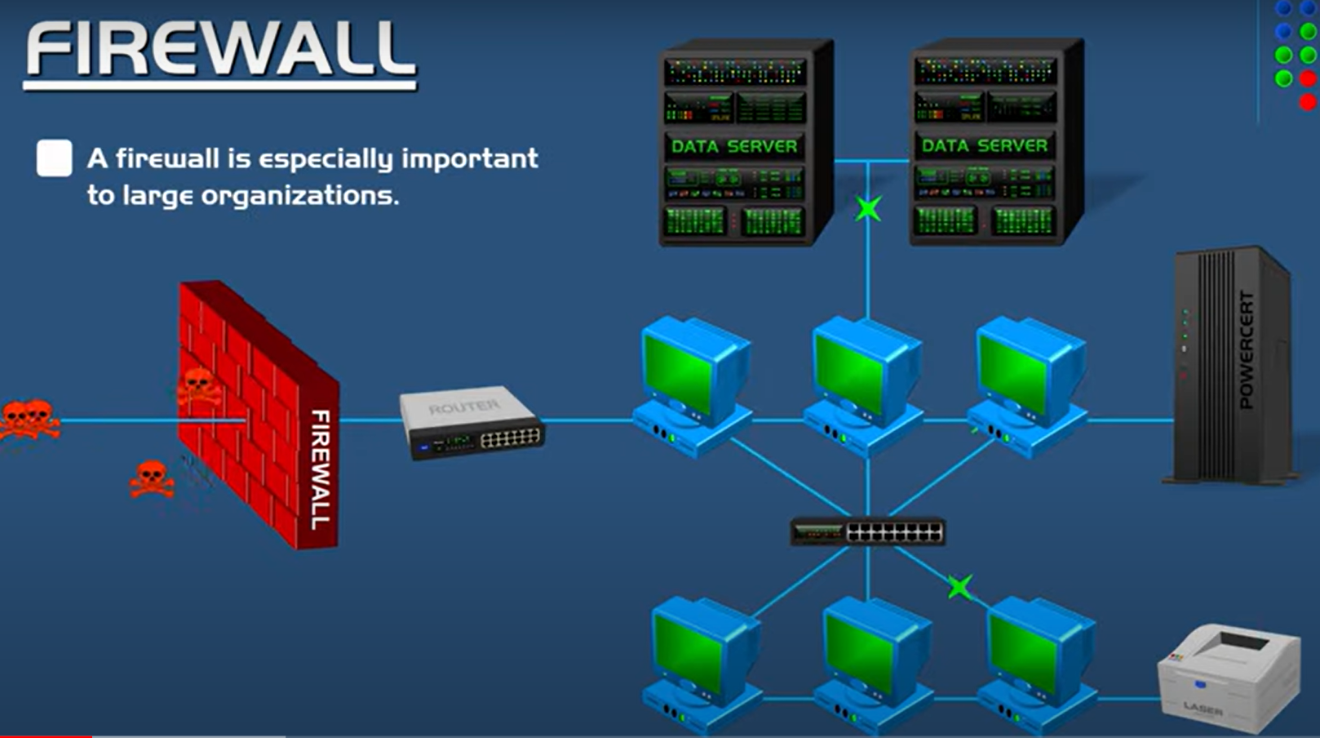
Firewalls

Slide 9
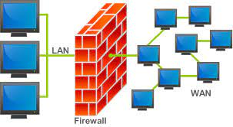
Firewall
A firewall is a network security device that monitors incoming and outgoing network traffic and decides whether to allow or block specific traffic based on a defined set of security rules.
A firewall can be software, hardware, or both

Slide 10
Firewall Basics
Interconnects networks with differing trust
Restricts network services – Only authorized traffic is allowed
Auditing and Access Control – Can raise alarms for abnormal behavior
Provide NAT and monitor usage
Implement VPN using IPSec
Must be immune to penetration

Slide 11
Firewall Limitations
Can be bypassed by trusted organizations, trusted services such as SSL/SSH
Cannot protect against internal threats
Cannot protect against virus-infected files or programs because of their sheer range

Slide 12
Firewall Classification
Packet filter
Application gateway (Proxy)

Slide 13
Packet Filter

Slide 14
Packet Filter
Simplest and fastest
Examines every packet and applies rules, decides accordingly
Generally do not do anything based on the data itself
Filtering rules: IP addresses, port numbers, Transport protocols and interfaces
Conservative approach: Deny all, allow selectively
Aggressive approach: Allow all, deny selectively

Slide 15
Packet Filter – Examples of Usage
Possible:
Don't let anybody use Telnet to log in from the outside.
Let everybody send us email via SMTP.
Not possible:
This user can Telnet in from outside, but no other users can do so.
(Because "user" isn't something a packet filtering system can identify.)
Not possible:
You can transfer these files but not those files.
(Because "file" also isn't something the packet filtering system can identify.)

Slide 16
Real Benefits of a Packet Filter
The main advantage of packet filtering is leverage: it allows you to provide, in a single place, particular protections for an entire network.
Consider the Telnet service as an example. If you disallow Telnet by turning off the Telnet server on all your hosts, you still have to worry about someone in your organization installing a new machine (or reinstalling an old one) with the Telnet server turned on.
On the other hand, if Telnet is not allowed by your filtering router, such a new machine would be protected right from the start, regardless of whether or not its Telnet server was actually running.

Slide 17
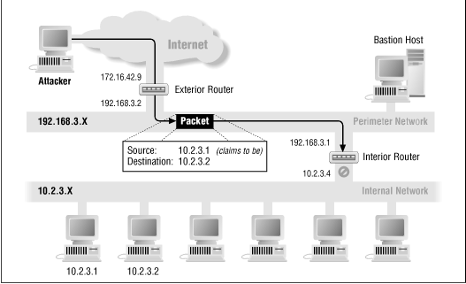
Address-spoofing Attacks
It is a good idea to reject all packets that have internal source addresses - that is, packets that claim to be coming from internal machines but that are actually coming in from the outside - because such packets are usually part of address-spoofing attacks.
In such attacks, an attacker is pretending to be coming from an internal machine.
Decision-making of this kind can be done only in a filtering router at the perimeter of your network.
Only a filtering router in that location (which is, by definition, the boundary between "inside" and "outside") is able to recognize such a packet, by looking at the source address and whether the packet came from the inside (the internal network connection) or the outside (the external network connection).

Slide 18
Packet Filter Advantages
One screening router can help protect an entire network
A single, strategically placed packet filtering router can help protect an entire network. If there is only one router that connects your site to the Internet, you gain tremendous leverage on network security, regardless of the size of your site, by doing packet filtering on that router.
Packet filtering doesn't require user knowledge or cooperation
Unlike in proxy systems, packet filtering doesn't require any custom software or configuration of client machines, nor does it require any special training or procedures for users. When a packet filtering router decides to let a packet through, the router is indistinguishable from a normal router. Ideally, users won't even realize it's there, unless they try to do something that is prohibited by the packet filtering router's filtering policy. This "transparency" means that packet filtering can be done without the cooperation, and often without the knowledge, of users.

Slide 19
Packet Filter Advantages
Packet filtering is widely available in many routers
Packet filtering capabilities are available in many hardware and software routing products, both commercial and freely available over the Internet. Most sites already have packet filtering capabilities available in the routers they use.

Slide 20
Packet Filter Drawbacks
Current filtering tools are not perfect
The packet filtering rules tend to be hard to configure.
Once configured, the packet filtering rules tend to be hard to test.
The packet filtering capabilities of many of the products are incomplete, making implementation of certain types of highly desirable filters difficult or impossible.

Slide 21
Packet Filter Configuration
First decide what services you want to allow or deny, and then translate your decisions into rules about packets.
In reality, you probably don't care about the details of packets at all.
Points to keep in mind:
Protocols are usually bidirectional: For example, you allow outgoing SSH connections, but then you must also allow incoming responses
Inbound/Outbound semantics: Inbound/outbound packets and services can be all very confusing. Example: An outbound SSH service involves both outbound and incoming packets. Most people think about services when using packet filters, but we need to think about packets.
Default permit versus default deny: Conservative or aggressive?

Slide 22
Types of Packet Filtering
Static packet filtering firewall
Manual ACL configuration is used
Dynamic packet filtering firewall
Flexible configuration is used (e.g. allow ports to remain open for certain time)
Stateless packet filtering firewall
Traditional – Every packet is different
Stateful packet filtering firewall
Detect TCP connections and then filter (i.e. keep track of client-server connections)

Slide 23
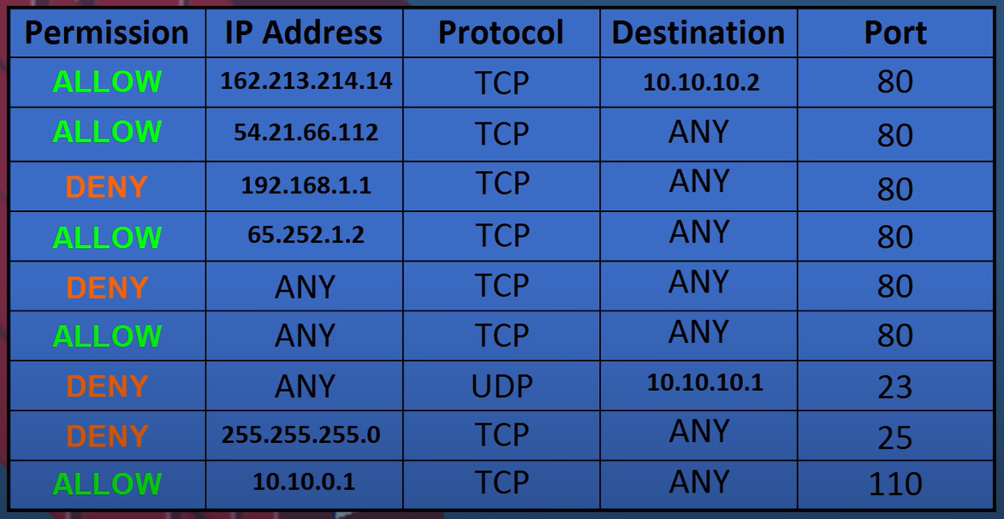
Packet Filter Rules Example

Slide 24
Packet Filter Case Study

Slide 25
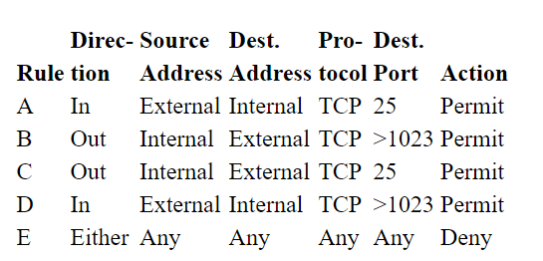
Sample Rules for SMTP
Allow inbound and outbound SMTP traffic
Rules A and B are for incoming emails (Outside user sends an email to our internal SMTP server)
Rules C and D are for outgoing emails (Internal user sends an email to an outside SMTP server)
Rule E is the default – what happens when everything else fails

Slide 26
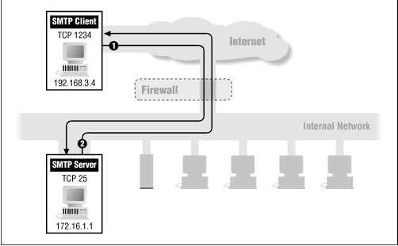
Packet Filter – Example of Incoming Email

Slide 27
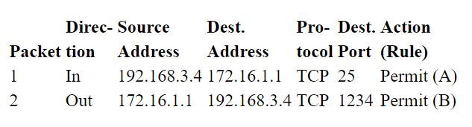
Packet Filter – Example of Incoming Email
Suppose that your IP address is 172.16.1.1, and that someone is trying to send you an email from the remote host with IP address 192.168.3.4. Further, let's say the sender's SMTP client uses port 1234 to talk to your SMTP server, which is on port 25.

Slide 28
Packet Filter – Example of Incoming Email
Suppose that your IP address is 172.16.1.1, and that someone is trying to send you an email from the remote host with IP address 192.168.3.4. Further, let's say the sender's SMTP client uses port 1234 to talk to your SMTP server, which is on port 25.
Rule A permits incoming packets from the sender's SMTP client to your SMTP server (represented by packet number 1 above).
Rule B permits the responses from your server back to the sender's client (represented by packet number 2 above).

Slide 29
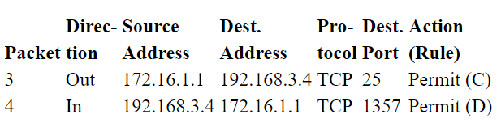
Packet Filter – Example of Outgoing Email
Suppose our SMTP client uses port 1357 to talk to the server’s SMTP server

Slide 30
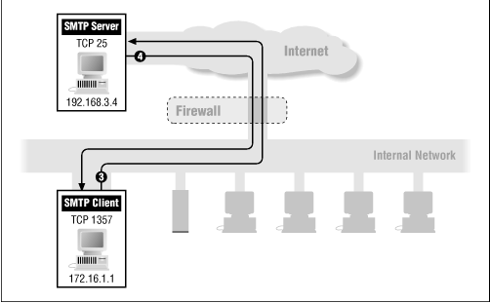
Packet Filter – Example of Outgoing Email

Slide 31
Packet Filter – Example of Outgoing Email
Suppose our SMTP client uses port 1357 to talk to the server’s SMTP server
Rule C permits outgoing packets from your SMTP client to their SMTP server (represented by packet number 3 above).
Rule D permits the responses from their server back to your client (represented by packet number 4 above).

Slide 32
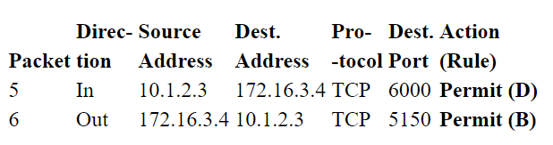
Packet Filter – Attack from Outside
Someone in the outside world (on host 10.1.2.3) attempts to open a connection from port 5150 on port 6000 on one of your internal systems (for example, 172.16.3.4) in order to carry out an attack

Slide 33
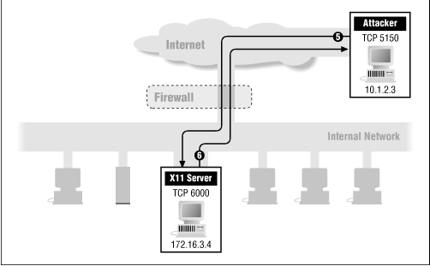
Packet Filter – Attack from Outside

Slide 34
Packet Filter – Attack from Outside
Someone in the outside world (on host 10.1.2.3) attempts to open a connection from port 5150 on port 6000 on one of your internal systems (for example, 172.16.3.4) in order to carry out an attack
Rules A and B together do what you want to allow inbound SMTP connections.
Rules C and D together do what you want to allow outbound SMTP connections.
But Rules B and D together end up allowing all connections where both ends are using ports above 1023, and this is certainly not what you intended.

Slide 35
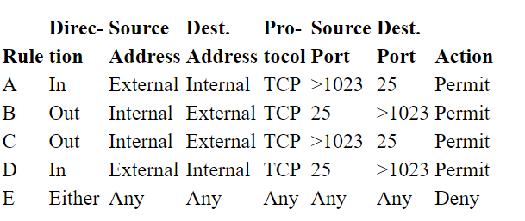
How to Address this? (Add Source Port Number also)

Slide 36
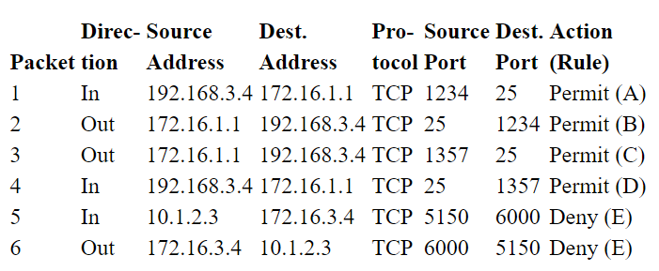
How to Address this? (Add Source Port Number also)

Slide 37
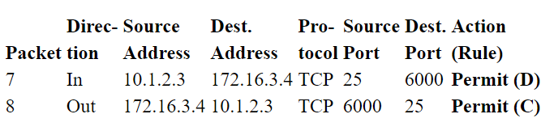

The Attack gets Smarter
What if the attacker uses port 25 as the client port?

Slide 38
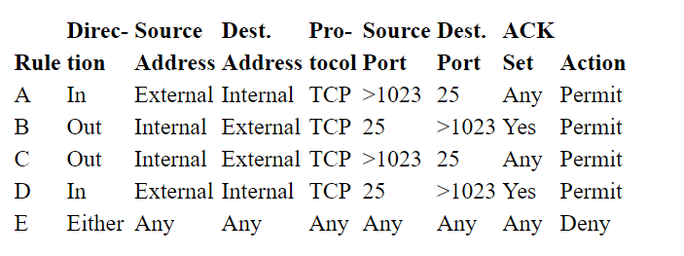
How to Address this?

Slide 39
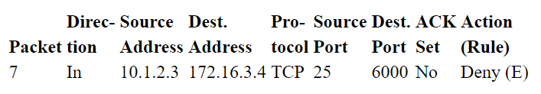
How to Address this? (Add Ack Check)

Slide 40
Can an Attacker not Breach this?
Why can't an attacker get around this by simply setting the ACK bit on the first packet?
If she does, the packet will get past the filters, but the destination will believe the packet belongs to an existing connection (instead of the one with which the packet is trying to establish a new connection).
When the destination tries to match the packet up with the supposed existing connection, it will fail because there isn't one, and the packet will be ignored.

Slide 41
Application Gateway (Proxy)

Slide 42
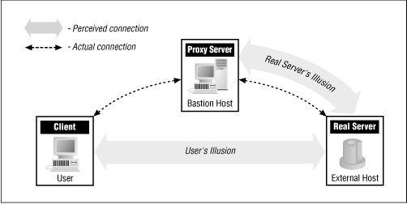
Basic Concept
The user's client program talks to a proxy server instead of directly to the "real" server out on the Internet. The proxy server evaluates requests from the client and decides which to pass on and which to disregard.
If a request is approved, the proxy server talks to the real server on behalf of the client (thus the term "proxy"), and proceeds to relay requests from the client to the real server, and to relay the real server's answers back to the client.

Slide 43
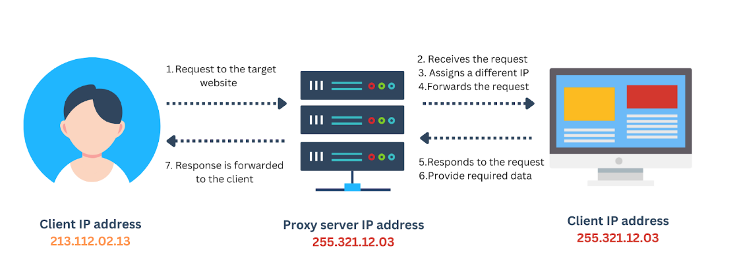
Example

